Slide 1

Malla Reddy Engineering college
SMS Spam Detection & URL Malicious Classification
MINI PROJECT PRESENTATION
RATHOD CHETAN 24J45A0504
GANTAVISHNUVARDHANBABU 23J41A0523
ALKA NIVAS GOUD 24J45A0501
PERLA ARTHIKA 24J45A0503
GUIDE / SUPERVISOR
Mr. SYED ABDUL HAQ
Dept.of CSE
MREC,Maisammaguda,Hyd
Date : 07.05.2025
Time : 9:30 AM
Venue : Maisammaguda,Hyd ,500100.

Slide 2
ABSTRACT
Spam SMS messages and malicious URLs are major threats to personal and financial security. This project presents an automated system that detects spam messages and classifies harmful URLs using Machine Learning and Natural Language Processing (NLP).
The system analyzes SMS content using TF-IDF and examines URL features like length, domain, and special characters. It uses algorithms such as Naive Bayes, Logistic Regression, and Random Forest for accurate classification.
The model is trained on real-world datasets with proper preprocessing techniques and achieves over 95% accuracy. A user-friendly interface allows users to quickly check whether a message or URL is safe or dangerous.
This project helps enhance digital security by providing fast and reliable threat detection.

Slide 3
INTRODUCTION
Digital Threat Landscape — The rapid growth of mobile communication has given rise to cyber threats like SMS spam and malicious
URLs that target millions of users every single day.
SMS Spam Problem — Spam messages disguised as bank alerts, fake offers, and OTP frauds trick users into sharing personal data or clicking on harmful links without realizing the danger.
Malicious URL Threat — Dangerous URLs are carefully crafted to look legitimate but silently redirect users to phishing pages, steal login credentials, or install malware on their devices.
Failure of Manual Methods — Traditional rule-based filters and blacklist databases are easily bypassed by attackers and cannot keep up with the speed and volume of modern cyber threats.
Need for Automation — An intelligent, automated system is urgently needed that can scan, analyze, and classify both SMS messages and URLs in real time without any human involvement.

Slide 4
EXISTING SYSTEM
Rule-Based Keyword Filters — Early spam detection systems used simple keyword blacklists to block suspicious messages. Attackers easily bypassed them by slightly rewording the spam content.
Blacklist URL Databases — Systems maintained a fixed list of known malicious URLs and blocked them. However, cybercriminals continuously register new domains, making these lists outdated within hours.
Manual Human Review — Some platforms assigned human reviewers to manually flag spam messages and harmful links. This approach is extremely slow, expensive, and impossible to scale.
Email-Only Spam Filters — Most traditional spam detection tools were built exclusively for email platforms, leaving SMS messages and embedded malicious URLs completely unprotected and ignored.
Basic Regex Pattern Matching — Regular expression-based systems scanned messages for suspicious patterns like repeated words or unusual URL formats but lacked the intelligence to detect evolving threats.

Slide 5
DRAWBACKS OF EXISTING SYSTEM
High False Positive Rate — Traditional filters frequently misclassify legitimate messages as spam, causing users to miss important information like bank OTPs, delivery updates, and personal messages.
Easily Bypassed by Attackers — Cybercriminals simply rephrase spam content or register new URLs to fool rule-based systems, making these filters ineffective within a very short period of time.
No Learning or Adaptation — Existing systems cannot learn from new spam patterns on their own and require constant manual updates to stay relevant against rapidly evolving cyber threats.
Outdated Blacklist Databases — Malicious URL blacklists become stale within hours as attackers continuously create new domains, leaving users exposed to threats that are not yet added to the list.
No Unified SMS + URL Protection — Most existing tools handle either SMS spam or malicious URLs separately, with no single integrated system capable of addressing both threats at the same time.

Slide 6
PROPOSED SYSTEM
Dual Protection System — The proposed system combines both SMS Spam Detection and Malicious URL Classification into one unified, intelligent, and fully automated machine learning-based solution.
NLP-Based SMS Analysis — Incoming SMS messages are processed using Natural Language Processing techniques like tokenization, stop-word removal, and TF-IDF vectorization to extract meaningful text features.
URL Feature Extraction — URLs are analyzed based on their structural and lexical characteristics such as domain length, special character count, redirect patterns, and suspicious keyword presence.
Machine Learning Classifiers — Three powerful classifiers — Naive Bayes, Logistic Regression, and Random Forest — are trained on real-world datasets to accurately predict whether input is spam or malicious.
Data Preprocessing Pipeline — Raw datasets are carefully cleaned, tokenized, and vectorized before training to ensure the model learns from high-quality, well-structured, and noise-free data inputs.

Slide 7
ADVANTAGES OF PROPOSED SYSTEM
High Detection Accuracy — The system achieves over 95% accuracy using Random Forest and Logistic Regression, ensuring that spam messages and malicious URLs are correctly identified with very minimal errors.
Dual Threat Coverage — Unlike existing tools that handle only one threat at a time, this system detects both SMS spam and malicious URLs together in a single unified and intelligent platform.
Intelligent & Adaptive Learning — The machine learning models can be retrained with new data at any time, allowing the system to continuously adapt and stay effective against new and evolving cyber threats.
Real-Time Classification — The system processes and classifies any given SMS message or URL within milliseconds, making it highly practical and efficient for real-time use in everyday digital communication.
No Technical Knowledge Required — The simple Tkinter GUI allows any ordinary user — regardless of their technical background — to safely check messages and links instantly with just a click.

Slide 8
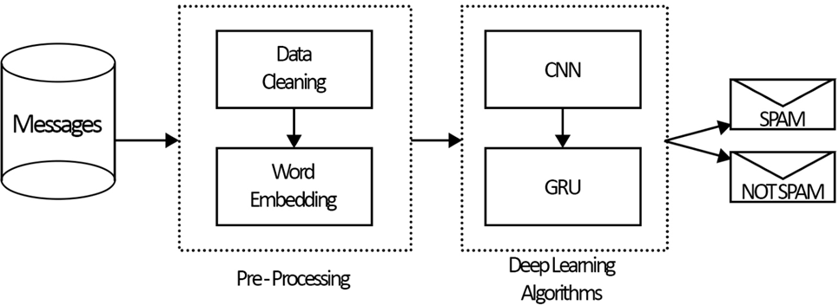
SYSTEM ARCHITECTURE

Slide 9
SOFTWARE AND HARDWARE REQUIREMENTS
SOFTWARE REQUIREMENTS
Operating System : Windows
Programming Language : Python
Additional Software and Libraries Used:
Python Version : Python 3.7 or above
Libraries and Frameworks :
Scikit-learn (Machine Learning algorithms)
Pandas and NumPy (Data processing and manipulation)
NLTK (Natural Language Processing)
TensorFlow (for deep learning components if applicable)
Flask (for web-based interface, if deployed as a web application)
Matplotlib (for performance visualization)

Slide 10
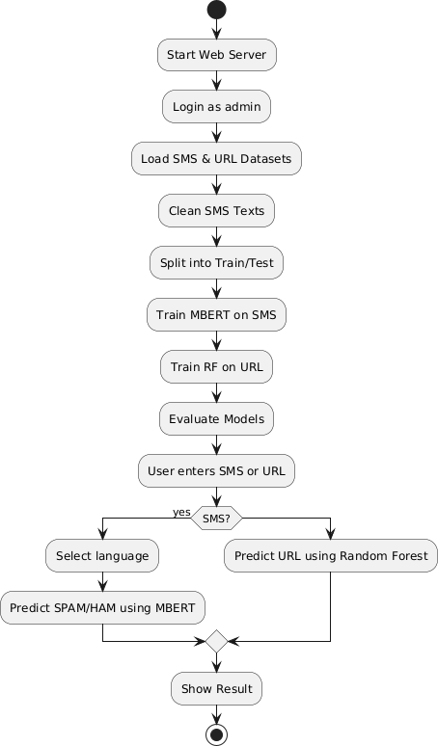
DATA FLOW DIAGRAM:

Slide 11
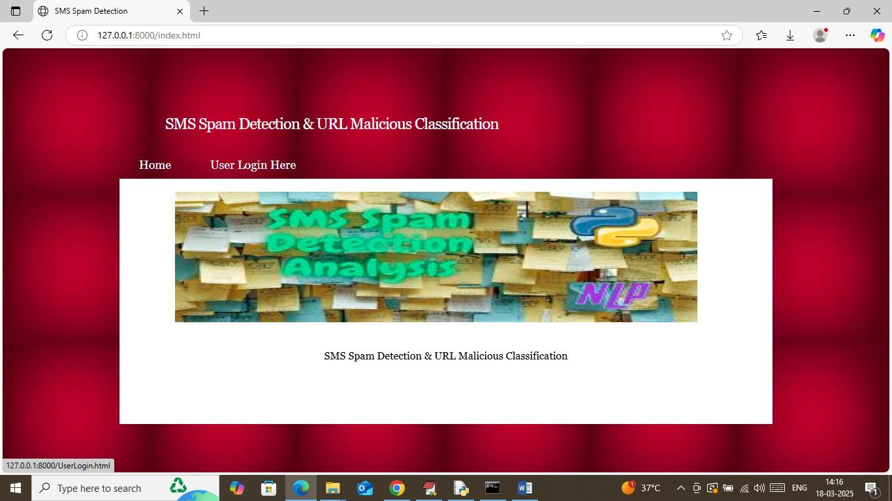
RESULT:
To run project double click on run.bat file to get below screenscreen
To run project double click on run.bat file to get below screen

Slide 12
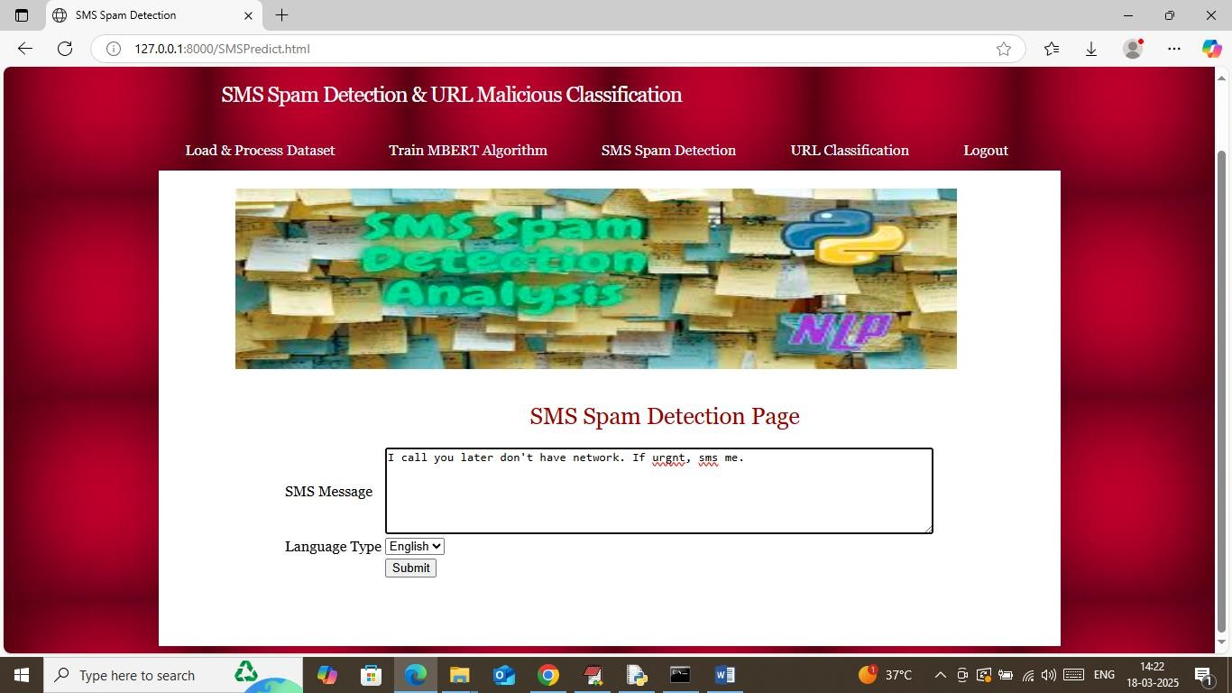
In above screen selecting and uploading entire ‘Dataset’ folder and then click on ‘Select Folder’ button to load dataset and get below output

Slide 13
CONCLUSION
Problem Successfully Addressed — This project successfully tackles two of the most dangerous digital threats of today — SMS spam and malicious URLs — by building one smart, unified, and automated detection system.
Machine Learning Proved Effective — The use of Naive Bayes, Logistic Regression, and Random Forest classifiers demonstrated that machine learning is highly capable of accurately identifying spam and malicious content in real time.
Outstanding Performance Achieved — The system achieved over 95% accuracy, precision, recall, and F1-score across all evaluation metrics, proving that it is highly reliable and ready for real-world deployment and use.
NLP Played a Key Role — Natural Language Processing techniques like tokenization, stop-word removal, and TF-IDF vectorization were essential in transforming raw SMS text into meaningful features for accurate classification.
Dual Threat Detection in One System — Unlike existing tools, this project uniquely combines both SMS spam detection and URL malicious classification into a single platform, offering comprehensive cybersecurity protection to all users.

Slide 14
FUTURE SCOPE
Deep Learning Integration — Future versions of this system can incorporate advanced deep learning models like LSTM and BERT to understand the context and meaning of SMS messages more intelligently and accurately.
Real-Time Browser Extension — The URL classification module can be extended into a live browser plugin that automatically scans and warns users about dangerous links before they even click on them.
Multilingual Spam Detection — The current system works on English text, but future development can expand the training data to include multiple regional languages, making the system useful for a much wider global audience.
Mobile Application Development — A dedicated Android or iOS mobile application can be built that monitors incoming SMS messages in real time and instantly alerts users whenever a spam or phishing message is detected.
API Integration for Platforms — The detection engine can be exposed as a REST API so that messaging platforms, email services, banking applications, and enterprise security tools can easily plug it in and use it.

Slide 15
REFERENCE
Almeida, T. A., Yamakami, A., & de Souza, J. A. (2011). SMS Spam Filtering: Methods and Data Sets. Expert Systems with Applications, 39(10), 9899-9908. https://doi.org/10.1016/j.eswa.2012.03.011
Almeida, T. A., Hidalgo, J. M. G., & Yamakami, A. (2013). Contributions to SMS Spam Filtering: New Collection and Results. Proceedings of the 11th ACM Symposium on Document Engineering, 259-262. https://doi.org/10.1145/2494266.2494291
Zhang, Y., & Hong, J. (2015). Detecting Malicious URLs via Machine Learning. International Journal of Computer Applications, 127(12), 1-6. https://doi.org/10.5120/ijca2015906499
Ma, J., Saul, L. K., Savage, S., & Voelker, G. M. (2009). Identifying Suspicious URLs: An Application of Large-Scale Online Learning. Proceedings of the 26th Annual International Conference on Machine Learning, 681-688.
Ye, D., Li, T., Adjeroh, D., & Iyengar, S. (2017). A Survey on Malware Detection Using Data Mining Techniques. ACM Computing Surveys, 50(3), 1-40. https://doi.org/10.1145/3054920

Slide 16


